Slide 1
WAITING TIME PREDICTION IN QUEUING SYSTEMS USING MACHINE LEARNING
- GROUP 1, TUTORIAL 2

Slide 2
Introduction to Queuing Theory
Why does Queuing Theory exists?
Queueing problems exist when multiple people need access to a resource, and the service cannot match the level of demand. On the one hand, queueing is a necessary evil when accessing valuable resources like health-related ones, as the idle time of those resources is expensive.Waiting in a queue can be stressful and exhausting for the clients because of the enforced idle time, and may lead to decreased customer satisfaction.
Queueing optimization techniques are used in several industries such as-
-banking
-healthcare
-retails
-education
-government
-telecom
Pranjal Jasani

Slide 3
Pros/Cons of Queuing Theory
Pros
Cons
Reduce wait times
Overall Client Satisfaction
Increase sales
Achieve Employee Efficiency
Reduce Operational Costs
Decrease Spread of Disease
No Contingency Plan
Limited Ability
System Errors
Cost
Pranjal Jasani

Slide 4
Machine Learning and Queuing Theory
Machine learning techniques and simulation models can also be of use to deal with queueing problems. An improvement to the prediction of the overall waiting time for daily radiation treatment appointments, when compared to the rough estimates.
We will try predicting solution for the scenario of clients waiting to be served in a bank. We will then propose our generic queueing system that can be used in various industries and can exploit queue specific parameters when predicting the estimated waiting time of the clients.
Pranjal Jasani

Slide 5
Dataset
Dataset: A collection of instances. It corresponds to the contents of a single database table, or a single statistical data matrix, where every column of the table represents a particular variable, and each row corresponds to a given member of the data set in question.
Training Dataset: A dataset that we feed into our machine learning algorithm to train our model.
Testing Dataset: A dataset that we use to validate the accuracy of our model but is not used to train the model. It may be called the validation dataset.
In our code, we split the dataset into training and testing datasets into 80% and 20% respectively.
The most supported file type for a tabular dataset is "Comma Separated File," or CSV.
In our code, we are analyzing a dataset with 3 banks for 5 days in a week. Unfortunately, the dataset does not specify the number of servers.
Pranavi G.

Slide 6
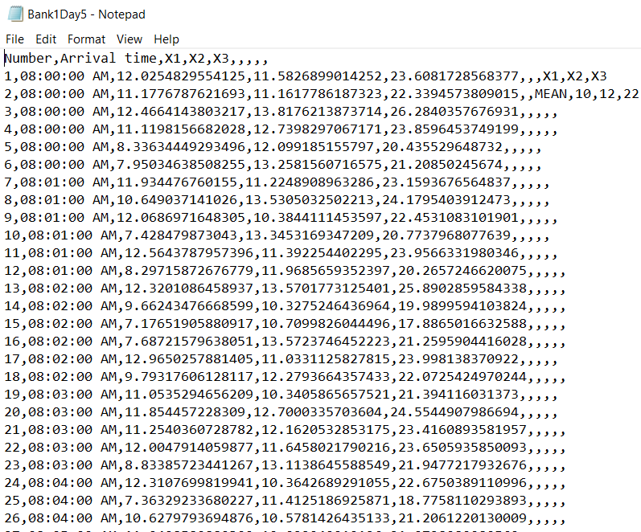
Dataset
Waiting minutes
Service minutes
X1 represents the time range between when a customer arrives at the bank and the time his/her cheque or withdrawal booklet was collected => waiting minutes
X2 represents the time used to process the cheque or withdrawal booklet => service minutes
X3 represents the total time in the system => total minutes
Arrival time
Total minutes
Row number
Pranavi G.

Slide 7
Data Preprocessing and Feature Engineering
We used the following features as the input for modeling: The people waiting in the queue,the day of the week,the hour,the waiting time variable forms the output of the model.
For each client, we have calculated the number of people waiting in the queue at the time the client joined the queue. To do so, we have calculated the queue departure time for each client by adding the waiting time to the arrival time, and then we counted the number of people that were yet to depart from the queue at the time a new client joined the queue.
We used mean encoding,also known as target encoding, to encode new features from those 3 existing categorical features and the target variable.The idea of mean encoding for a regression task is simple.
Raghav Gupta

Slide 8
Experimental Setup
Machine learning primarily involves two main parts- ‘developing’ or ‘building’ a model using certain machine learning algorithms and then ‘deploying’ that model to ,for instance, create predictive applications.
Our experimental setup involves only the first part, i.e., building the model. We have used Python 3 to build the model. We have used Jupyter notebooks. It integrates code and its output into a single document that combines visualizations, narrative text, mathematical equations, and other rich media.
We have used the data published along with a research paper by Bishop et al. It is titled ‘Survey dataset on analysis of queues in some selected banks in Ogun State, Nigeria’ and includes information regarding queues formed and served in 3 banks in Ogun State, Nigeria, over a period of 5 days.
We decided to use an artificial neural network (ANN) over other machine learning models.
Akshat Singh
Notes:
SLIDE 1

Slide 9
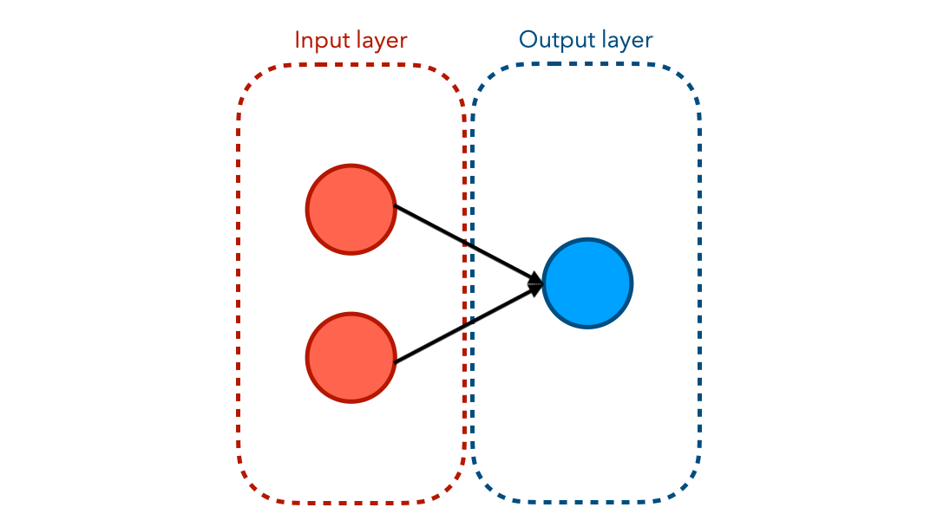
What are Artificial Neural Networks?
ANN (Artificial Neural Network) is a multi-layer network of neurons that we use to classify things, make predictions, etc. that are inspired by, but not identical to biological neural networks that constitute animal brains. Like the human brain consisting of many brain cells, ANN also consists of a collection of neurons that are interconnected. The ANN model consists of three layers mainly input layer, output layer and hidden layer(s).
Akshat Singh
Notes:
SLIDE 2

Slide 10
What are Artificial Neural Networks?
Each layer is connected by neurons with interconnection from input to output layers. The number of neuron in each layer depends on the nature of the problem, for example number of neurons in the input layer is fixed by number on inputs required while the number of output layer depends on our requirement of what we would like to calculate.The best suited number of neurons in the hidden layer for the particular problem with given input and output is selected to predict the unknown data.
In our code, we have 1 input layer with 12 neurons, 1 hidden layer with 8 neurons and 1 output layer with 1 neuron.
Such systems learn by looking at examples of an object like a cat or a dog and identify certain characteristics so they can determine this object in other images. These networks do not have to know anything about the object they are analyzing. They are intelligent enough to view a few examples and quickly classify things, make predictions, etc.
ANN (Artificial Neural Network) models gain more attention owing to their application in various fields like mathematics, transportation, weather and market trend forecasting etc.
Akshat Singh
Notes:
SLIDE 3

Slide 11

What are Artificial Neural Networks?
Example of an implementation of ANN model
Akshat Singh
Notes:
SLIDE 4

Slide 12
Why Artificial Neural Networks?
We have decided to use a neural network over other machine learning models because of the continuous training capabilities of a neural network. When a new batch of training data is gathered, an existing neural network can be trained solely on those, and there is no need to train on all available training data regularly. This is ideal for a queue management system, as new data are consistently.
Traditional Machine Learning algorithms tend to perform at the same level when the data size increases but ANN outperforms traditional Machine Learning algorithms when the data size is huge.
Akshat Singh
Notes:
SLIDE 5

Slide 13
How do Artificial Neural Networks work?
Weights play an important role in ANN. Every neuron has some weights. Neural Networks learn through the weights, by adjusting weights the neural networks decide whether certain features are important or not.
One epoch is when the entire dataset is passed forward and backward through the neural network only once. In our code, we have used 500 epochs.
Since one epoch is too big to feed to the computer at once we divide it in several smaller batches. The total number of training examples present in a single batch is called the batch size. In our code, we have taken the batch size as 256.
The working of ANN can be broken down into two phases: Forward Propagation and Back Propagation.
Akshat Singh

Slide 14
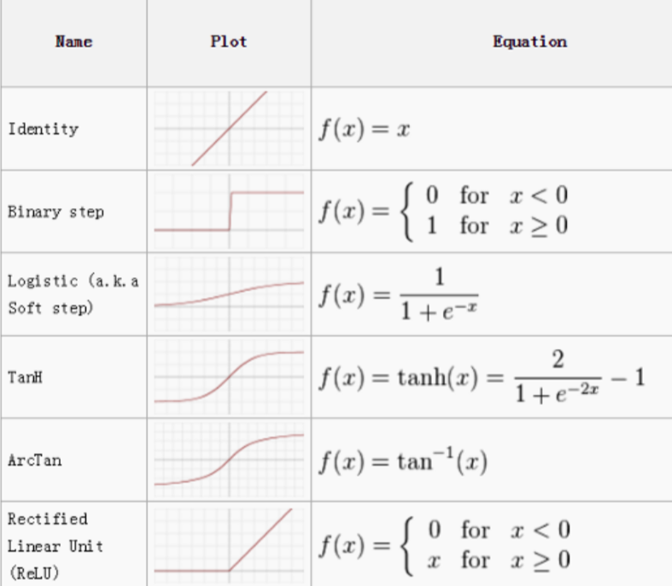
How do Artificial Neural Networks work?
Forward propagation involves multiplying weights, adding bias, and applying activation function to the inputs and propagating it forward.
The purpose of an activation function is to introduce non-linearity to the data. Introducing non-linearity helps to identify the underlying patterns which are complex. It is also used to scale the value to a particular interval. Examples of activation functions are sigma function, tanh function, ReLU function, linear function etc. In our code, we have used ReLU function for input and hidden layers and linear (identity) function for output layer.
Akshat Singh

Slide 15
How do Artificial Neural Networks work?
A function that is used to calculate error is called loss Function .Error is a function of internal parameters of the model i.e. weights and biases. Different loss functions are used to deal with different types of tasks such as regression and classification.
Broadly, loss functions can be classified into two major categories depending upon the type of learning task we are dealing with — Regression losses and Classification losses. In classification losses, we are trying to predict output from set of finite categorical values, for eg: given large data set of images of cats and dogs, predict whether given image is of cat or dog. Regression losses, on the other hand, deal with predicting a continuous value for eg: predict the price of room, predict the height of a person, or even predict the the waiting time in a queue - which is our case.
Akshat Singh

Slide 16
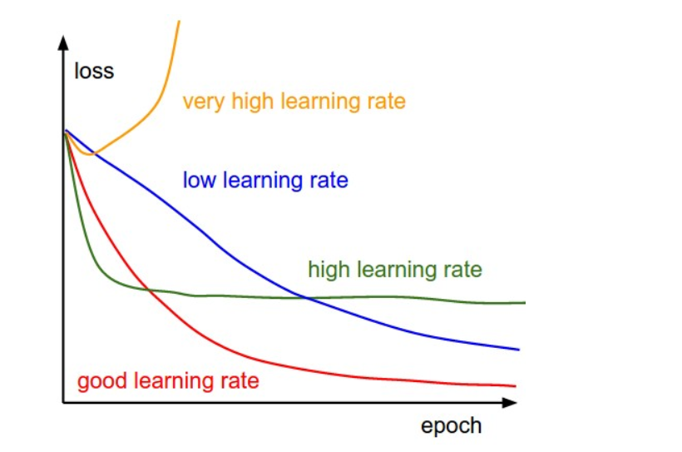
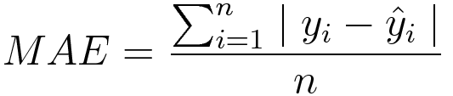
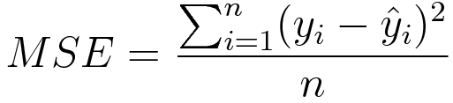
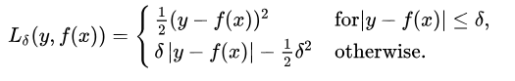
How do Artificial Neural Networks work?
Akshat Singh
There are several regression loss function - MSE(Mean Squared Error, MAE(Mean Absolute Error), Huber’s loss etc.
In our code, we use MAE as loss function. It is measured as the average of sum of absolute differences between predictions and actual observations.
Akshat Singh

Slide 17
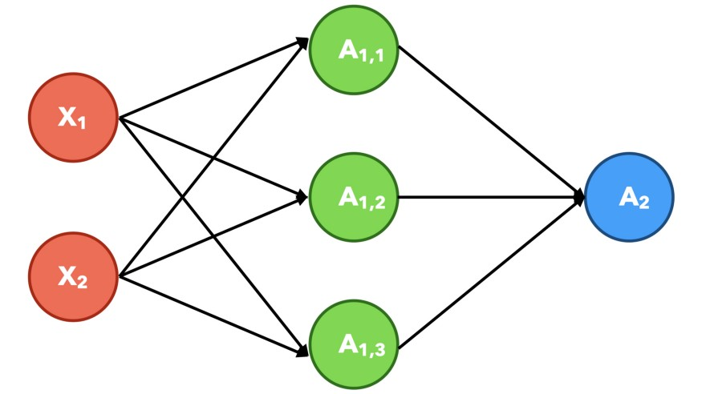
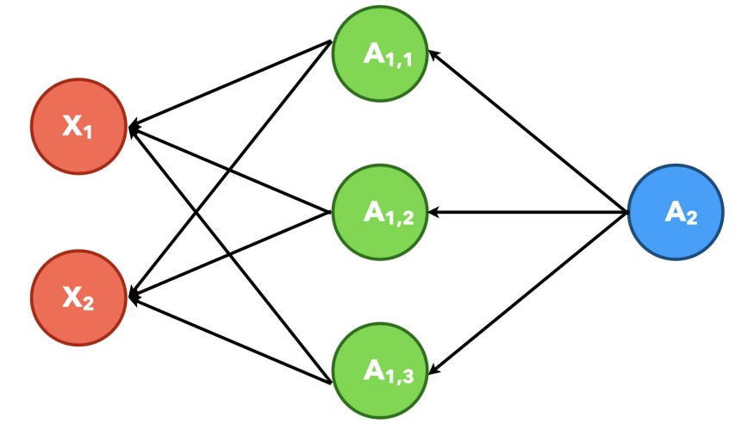
How do Artificial Neural Networks work?
For accurate prediction, one needs to minimize the error calculated using loss function. This is done during back propagation using optimization function or optimizer.The optimizers or optimization functions used in ANN varies, such as Adam (Adaptive Moment Estimation), RMSProp, Gradient Descent, etc. In our code, we have used Adam function as optimizer .
Forward propagation Back propagation
Akshat Singh

Slide 18
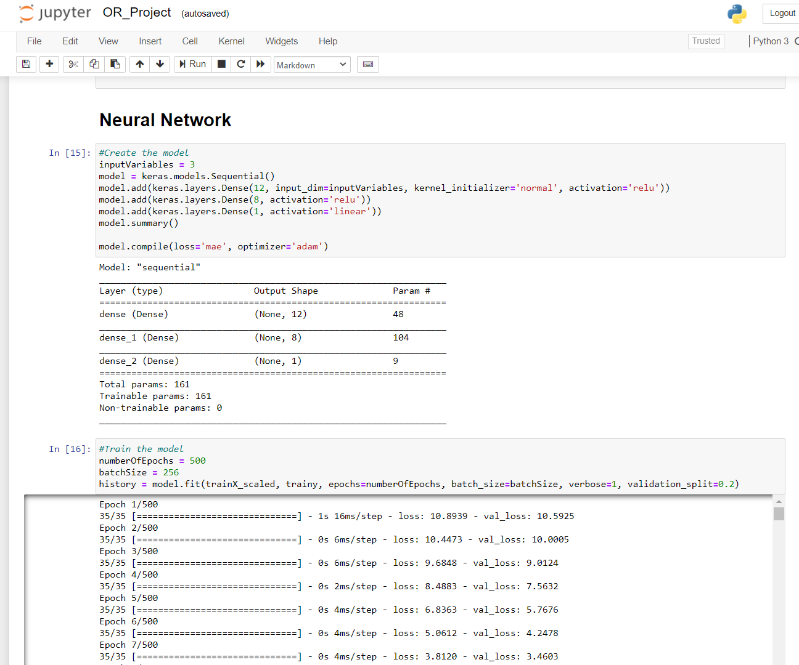
Code
Let’s run and analyse the code!
Akshat Singh

Slide 19
Results
After 500 epochs of training, a mean absolute error of 2.68 minutes was achieved on the test set.
To have an estimation of the predictive capability of the trained model, we are comparing against the naive mean and the naive median model; these are the models that always predict the mean and the median waiting time of the training set.
The naive mean model had a mean absolute error of 2.94 minutes on the test set, and the naive median an error of 2.94 minutes. Our model has, therefore, achieved an improvement of 8.8% over the naive mean model and 8.8% over the naive median one.
Akshat Deshmukh

Slide 20
Proposing a Generic Queuing System
QueueForMe: We are proposing, a web application that allows everyone to create a virtual queue allowing clients around to join and includes two types of users, the creators, and the clients. In a future version of this web application the creator of a queue will have the option to define a set of queue specific parameters along with the restricted set of responses for each parameter.
Simulator: To verify the learning capabilities of each neural network that is created with every queue, we can develop a simulator with which we can simulate customers joining a queue over a specific period of time.
Industry Specific Queue Simulation: In a future version of the simulator we will also include the queue specific additional parameters as described above. Each queue will have a predefined set of parameters, and each parameter will have a set of valid responses.
Ritik Pachauri

Slide 21
Conclusion
We have explored how machine learning will be used for predicting the waiting time of individuals queueing in lines. We started by employing a publically obtainable dataset of queues in banks, and by coaching a neural network, we achieved a mean absolute error of 2.68 minutes, improving over the performances of naive models. Sadly, we could not directly compare against queueing theory as a result of the dataset lacked info concerning the deployed servers. After presenting a particular case on how machine learning will be used predict waiting times in queueing situations, we are generalizing on a lot of industries. Using a simulator on web application, we are able to verify the prognostic capabilities of the queue specific neural networks. As future work, we'll embody the ability to feature queue specific parameters at the queue creation phase with predefined responses. This extra info will be exploited by the underlying waiting time-predicting neural network of every queue, and totally different distributions of each parameter response may be simulated exploitation the machine.
Shubhan Mital

Slide 22
References
Main References / Resources
The entire project structure is based on these resources:
Kyritsis A.I. and M. Deriaz, M. (2019). "A Machine Learning Approach to Waiting Time Prediction in Queueing Scenarios" , Second International Conference on Artificial Intelligence for Industries (AI4I), 17-21, doi:10.1109/AI4I46381.2019.00013.
Data has been collected from https://www.ncbi.nlm.nih.gov/pmc/articles/PMC5997939

Slide 23
References
Additional References/ Resources
The theory for ANN has been based on:
Senniappan, P. (2015). ANN Simulation of single server infinite capacity queuing system.
https://towardsdatascience.com/an-illustrated-guide-to-artificial-neural-networks-f149a549ba74
https://towardsdatascience.com/a-beginners-guide-to-neural-networks-d5cf7e369a13
https://towardsdatascience.com/understanding-neural-networks-19020b758230
https://towardsdatascience.com/introduction-to-artificial-neural-networks-ac338f4154e5
https://www.analyticsvidhya.com/blog/2020/11/popular-classification-models-for-machine-learning
https://towardsdatascience.com/understanding-the-3-most-common-loss-functions-for-machine-learning-regression-23e0ef3e14d3
https://towardsdatascience.com/common-loss-functions-in-machine-learning-46af0ffc4d23
https://towardsdatascience.com/epoch-vs-iterations-vs-batch-size-4dfb9c7ce9c9
https://medium.com/@vivek.atwal01/loss-function-back-propagation-optimization-function-f8e3cbd85923

Slide 24
TEAM MEMBERS:
1) Pranjal Jasani 2) Pranavi G. 3)Raghav Gupta 4)Akshat Singh 5)Akshat Deshmukh
6)Shubhan Mittal 7)Ritik Pachauri 8)Harrshit Limbodia 9) N. Muskan
THANK YOU

